Slide 1
Killing a legacy
Damien Malone
July 2017

Slide 2
Overview – Issues
Volume of change
Attracting the right fit employees
Employee Motivation
Aging employee demographic
Support Business Strategy

Slide 3
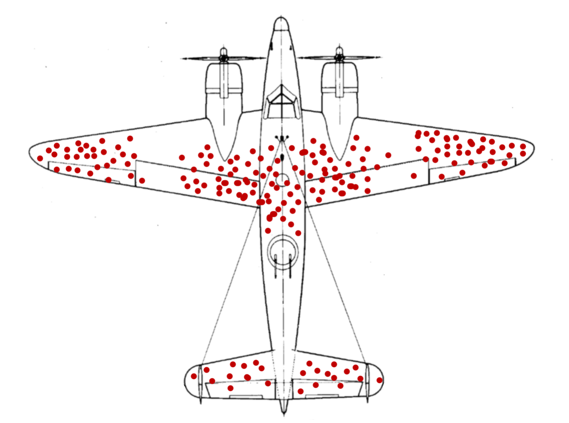
Beware of success stories

Slide 4

Where I Live

Slide 5

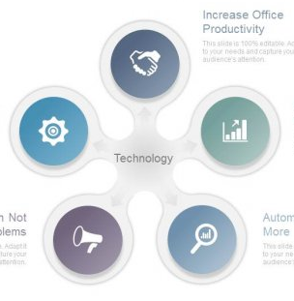
What I see (What good looks like)
Partner/Policy
Finance
CRM
HUB
Customer Comms
Analytics

Slide 6

Whats really there
Actual complex
View with large
Databases at the
Centre redacted

Slide 7
Killing the Legacy
Peoples Legacy
  People working on the legacy system may be reluctant to help you replace ‘their’ system, take their knowledge/power/job
  The senior management you need to convince to fund this may have built their career on the back of this implementation, its their baby.

Slide 8
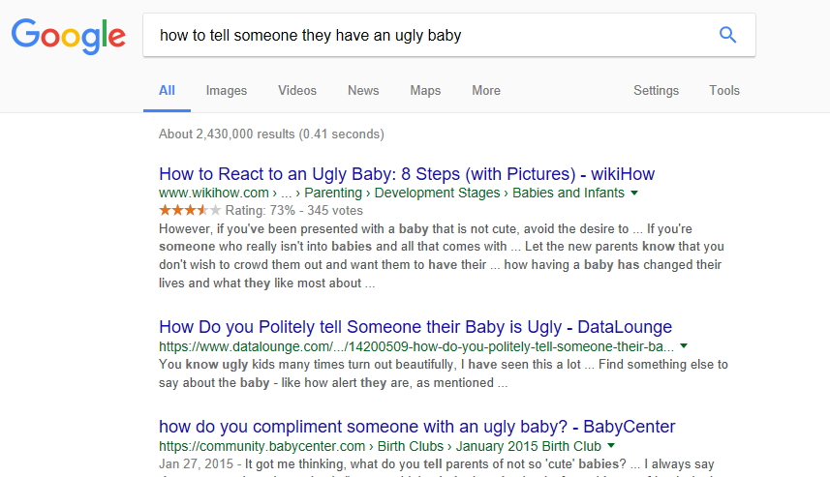
Peoples Legacy

Slide 9
Killing the Legacy
Legacy Systems
  3 Tier 1 systems that were legacy
    Website
    Core partner/policy/billing
    In-house claims system

Slide 10
Legacy Systems
All three systems
10< Years Old <20
We were risk averse in original product selection
Approx. €3b transactions between them

Slide 11
Approach 1 – Web Stack
>100k registered users
Small sales funnel (€10m)
Large lead generator/Information source
Bespoke MVC pattern, ~14years old

Slide 12
Approach 1 – Web Stack - Issues
Old technologies
Slow turnaround on change
Difficulty if getting skilled staff to work on it/support
Old look and feel with non-responsive front end

Slide 13
Approach 1 – Web Stack - Solution
Rip and replace easier than remediation
One foul swoop
Get business buy-in that no back end system changes are part of the project

Slide 14
Approach 1 – Web Stack - Solution
Pros
No scope creep
Suited waterfall methodology
Full control of delivery, no dependencies
Cons
No business uplift for 5 months with most of their budget blown

Slide 15








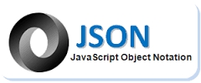


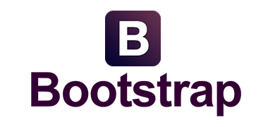














Web Technology Stack
Runtime
Presentation
Server
Content Management
Develop
Java Build
UX Build
Deploy
Test
QA

Slide 16
Approach 2 –Policy System
Centre of our universe
Oracle forms/DB system
Holds all partner/policy/Billing information

Slide 17
Issues
Web
CRM system
Customer Documentation
our
APIs
Vendor
APIs
Core
Business Logic

Slide 18
Issues - continued
Have you seen method names like this before???
SavePolicy(….)
SavePolicy1(….)
SavePolicyWeb(….)
SavePolicyLCRProject(….)
Layering without governance is just a more complicated mess

Slide 19
Approach 2 –Solution
Not the right time to rip and replace
Remediation too large for a system that is near EOL
For COTS going forward
  OOTB
  Configuration
  Customisation (Last resort)
Hide issues, centralise. Place System behind an API gateway

Slide 20
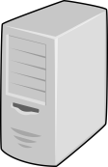


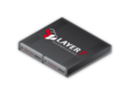
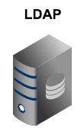




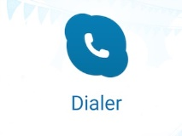


Approach 2 –Solution
Third Party
Systems
Mobile
Partner
CRM
Claims
Web
Logging
API
API
API
API
API
Partner
Claims
CRM
Members
CMS

Slide 21
Approach 2 –Solution
Pros
Hides complexities from downstream systems
Enables rip and replace in the future
Catalogue of dependent systems
Single point to replace/test
Enables REST api integration
Moves the DB away from the centre of the landscape
Allows for reusable components
Cons
Legacy System still on landscape
At times of pressure, should we take the old route

Slide 22











Enterprise Integration Stack
Runtime
Public Gateway/ Interface
Server
Develop
Java Build
Deploy
Test
QA

Slide 23
Approach 3 – Claims System
Bespoke claims system
Large man years effort
Large financial transactions per year
Has had no technology investment in 10 years
Risk adverse product selection to begin with

Slide 24
Approach 3 – Claims issues
Unwillingness of developers to work on this
Outsourcing teams couldn’t be ramped up
2 speed IT leading to demotivation
Technologies running out of support
Speed of enhancements
Architecture struggles to support multiple sites(chatty)

Slide 25
Approach 3 – Solution
Content Layer
JSP, HTML, CSS, AJAX DWR
Angular/ReactJS/JSON/Single Page
Presentation Layer
Spring Web Flow 1.0.3
Spring MVC / Bootstrap / Velocity
Logic Layer
Spring 2.0.1, Java 7
Spring 5, Java 9
BRE
Blaze Rules Advisor 7.3
Blaze Rules Advisor 7.4
Workflow
Custom Workflow
Apache Camel
ORM
TopLink 10.1.3
EclipseLink / Hibernate / Spring Data JPA
Application Server
WebLogic 12.1.3
WebLogic 12.2
Batch Layer
Spring 2.0.1, Java 7, PLSQL
Spring 5, Java 9, PLSQL
Database Layer
Oracle 12.1
Oracle 12.2
RM Layer
Ant 1.7, Ivy 2.2
Gradle

Slide 26
Approach 3 – Parallel Upgrade
Parallel Upgrade
Claims.war
Claims.jar
ClaimsV2.jar
Primary Care
Q3 2017
Create Case
Q4 2017
Adjudication
Q1 2018
Examination
Q2 2018
Review
Q4 2018
Dao.jar
rules.jar

Slide 27
Approach 3
Pros
  Allows for continued business value delivery
  Costs can be offset against change projects
  No big bang
Cons
  Compatibility issues
  Duplication for a time
  The long goodbye, still need to support legacy for a time

Slide 28
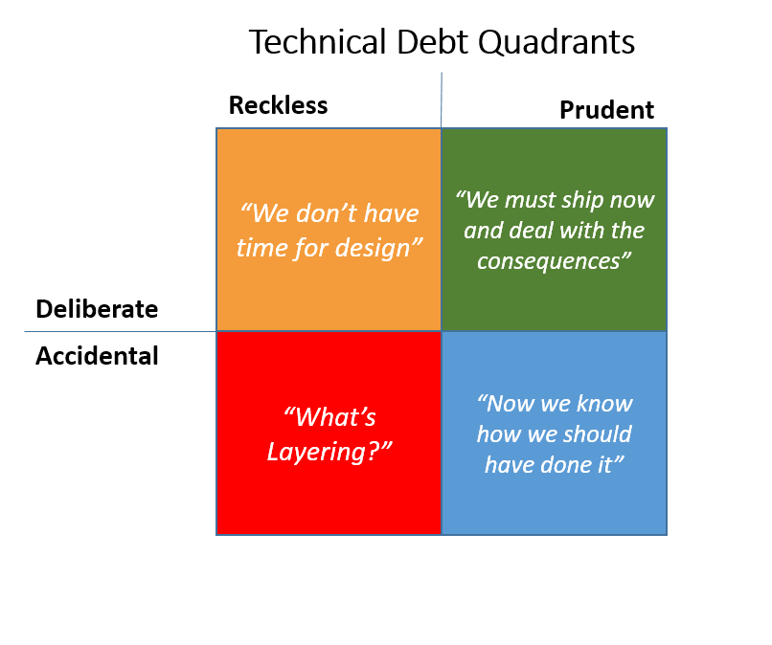
Killing Legacies Words of Warning
Technical Debt
Don’t confuse mindful
TD with Reckless TD
that you have no intention of
repaying
There is nothing more permanent
than a short term fix

Slide 29
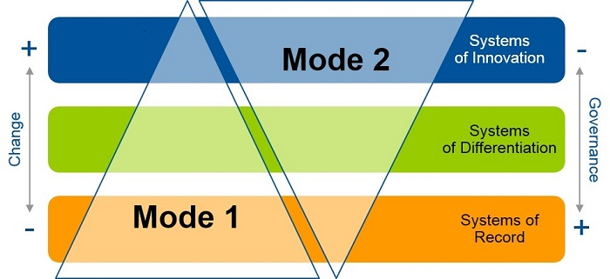


Killing Legacies Words of Warning
Bi-modal IT
FUN
MOTIVATION
{
What they
don’t tell you

Slide 30

Killing Legacies Words of Warning
Don’t be afraid to move back into the ivory tower (on rare occasions!!)
Just don’t be a Princess
about it

Slide 31
Software and Hardware are easy. Peopleware is the hard part.
Notes:
The solution to our communications issues ---- more communications

Slide 32

Notes:
WHO has the first question

